Slide 2
LLMs Limitations
LLMs are not trained for facts
Knowledge Cut off date
somewhat addressed in Sep 2023 , when it collobareted with Bing
Hallucinations
Knowledge Limitations
LLMs have not been trained on information such as internal company documents, internal company code, customer information, product documents, confidential personnel information,
Can be solved by parametric and non-parametric optimizations

Slide 3
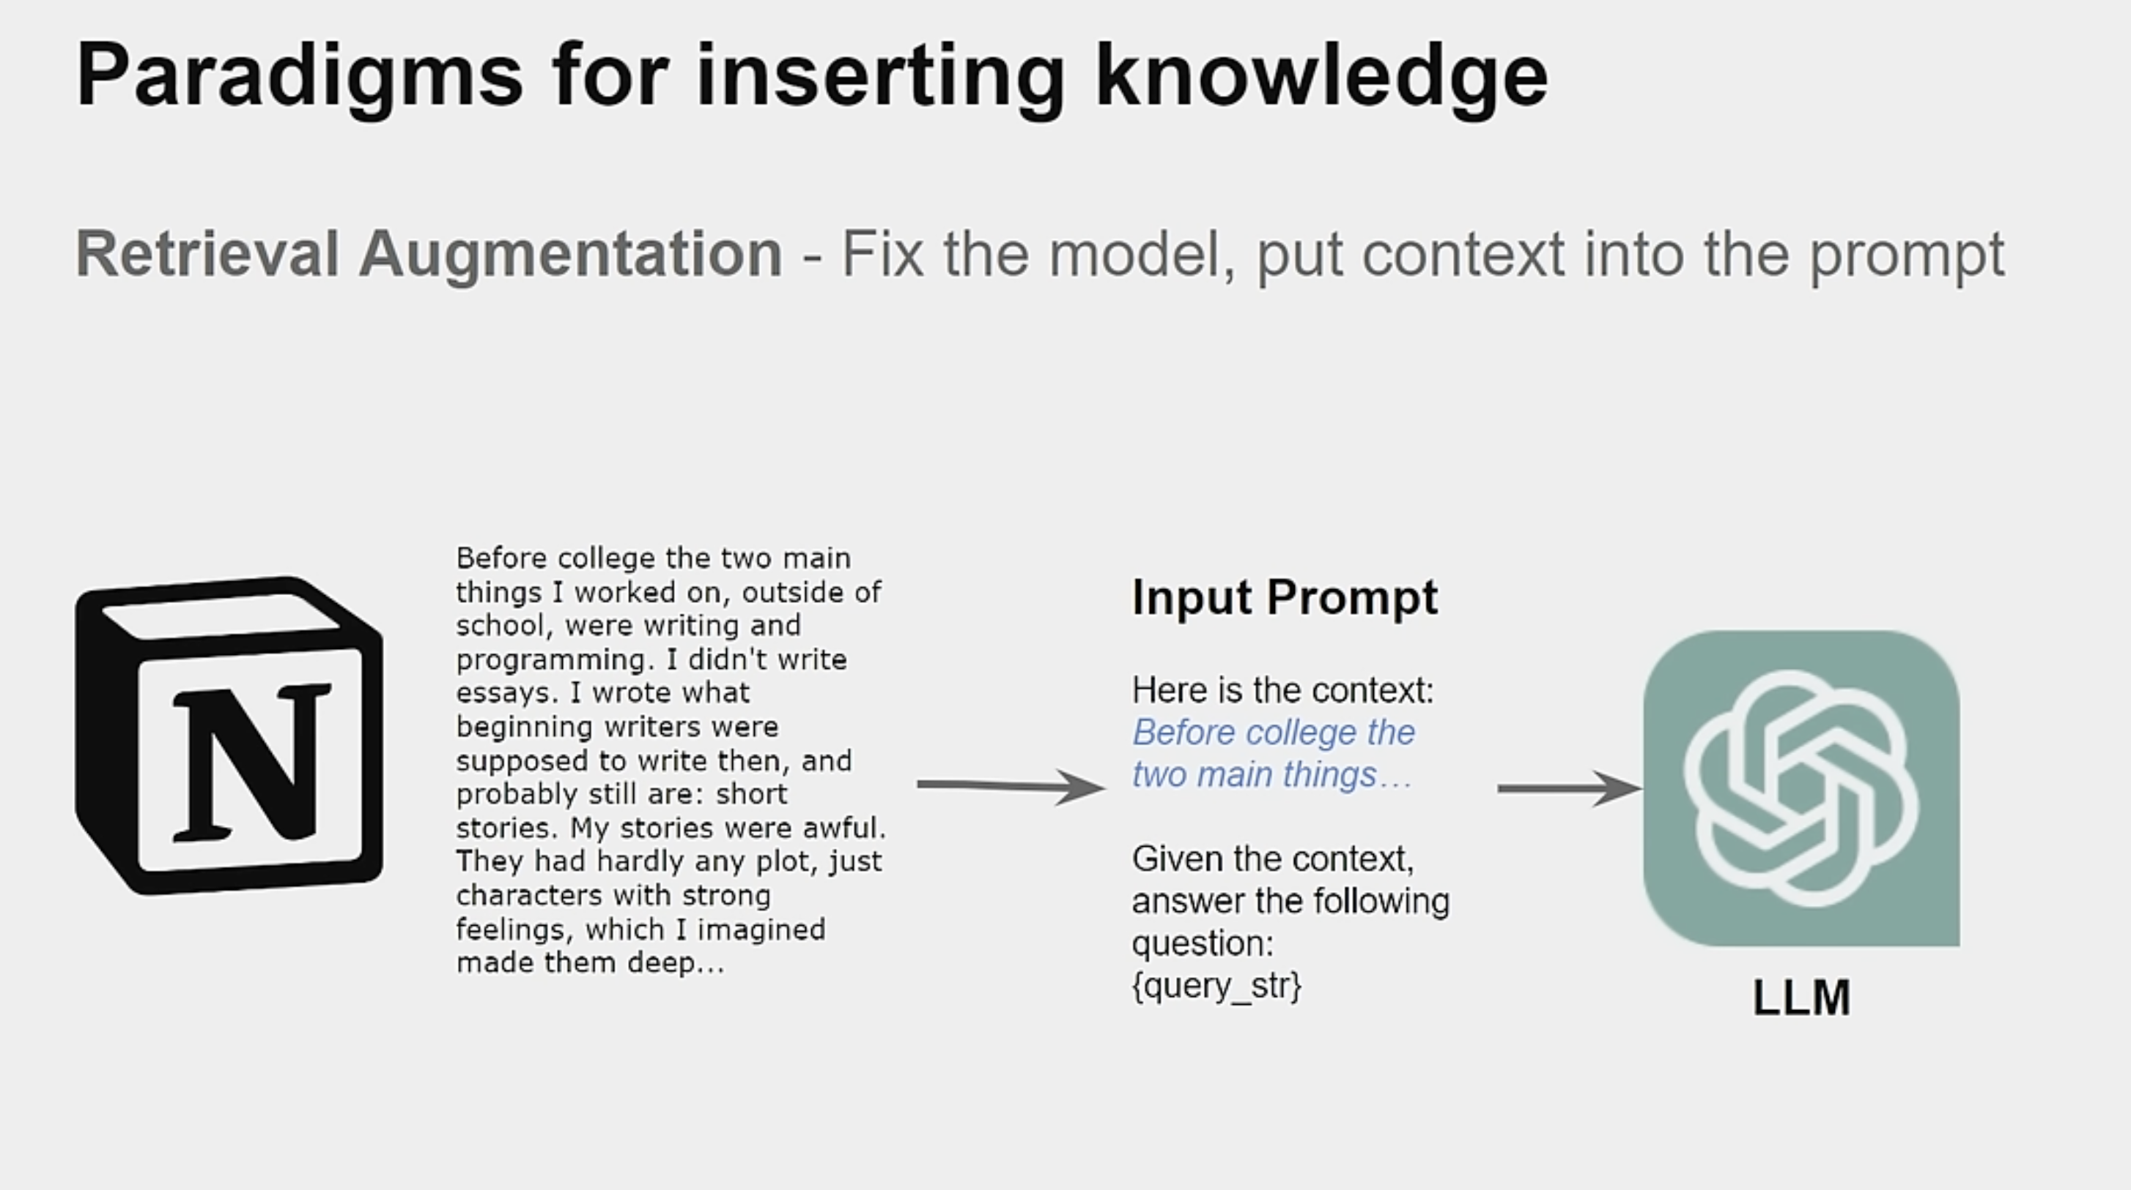

Slide 4
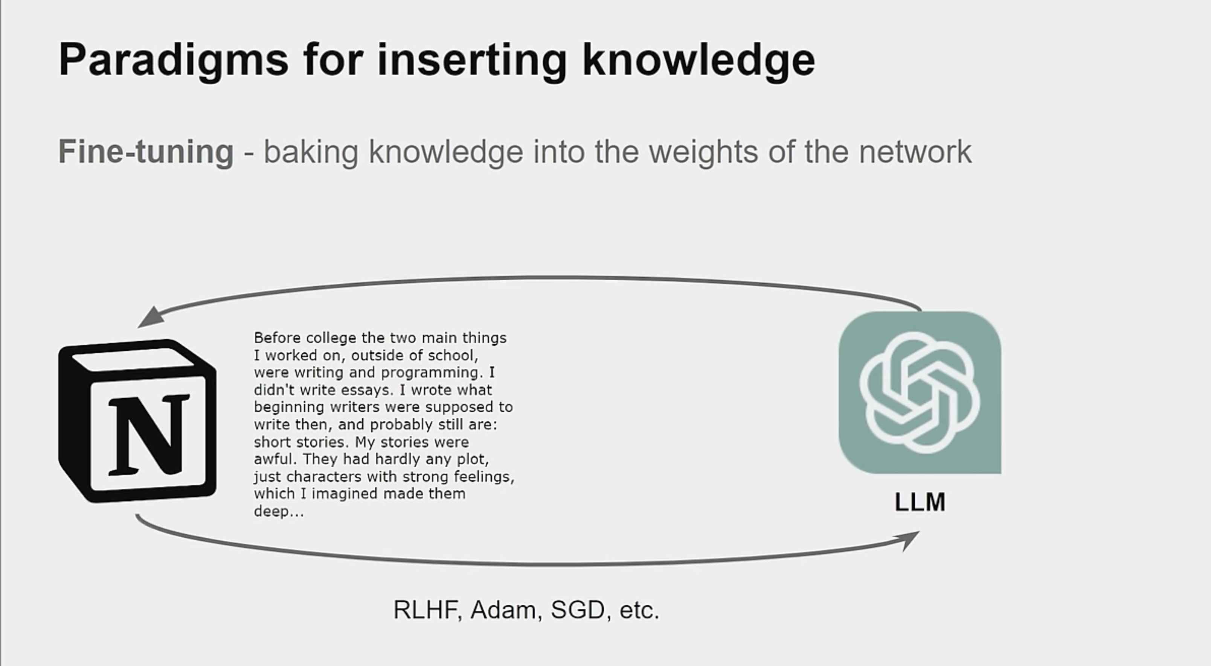

Slide 5
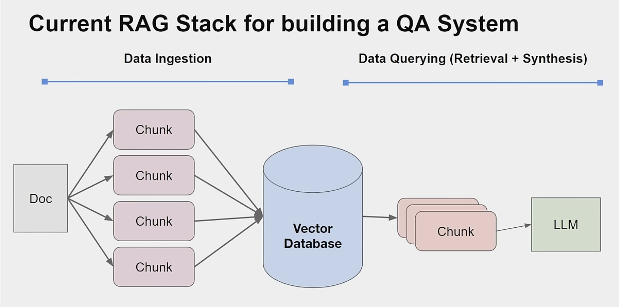

Slide 6
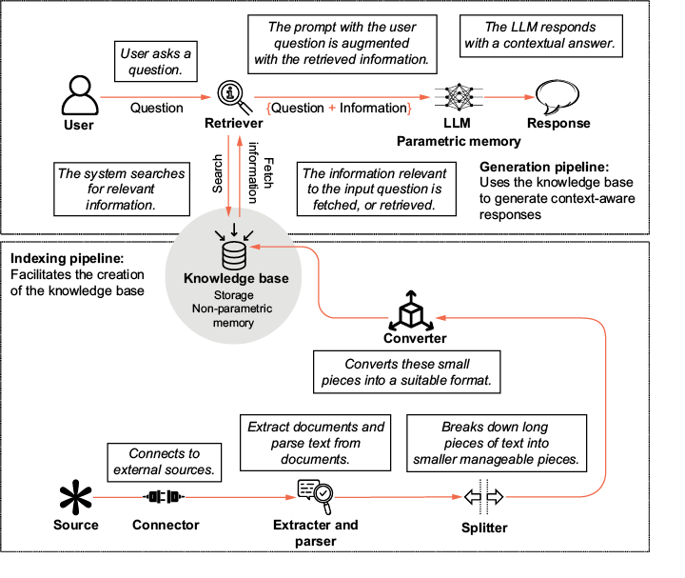
Data Ingestion pipeline

Slide 7
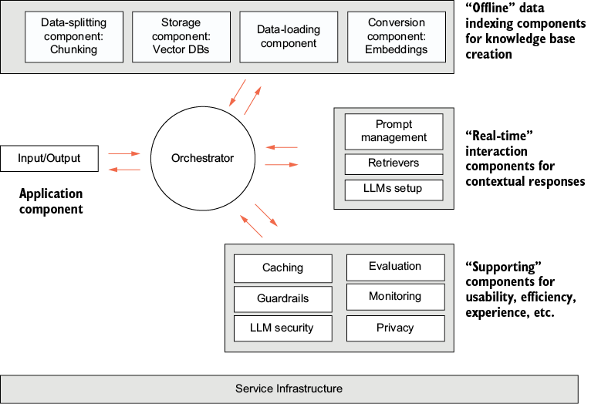
Components of a production ready RAG system

Slide 8
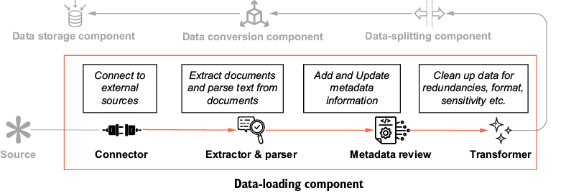
Data Loading
Connect to the source of data.
Extract text from the file.
Review and update metadata information.
Clean or transform the data.

Slide 9
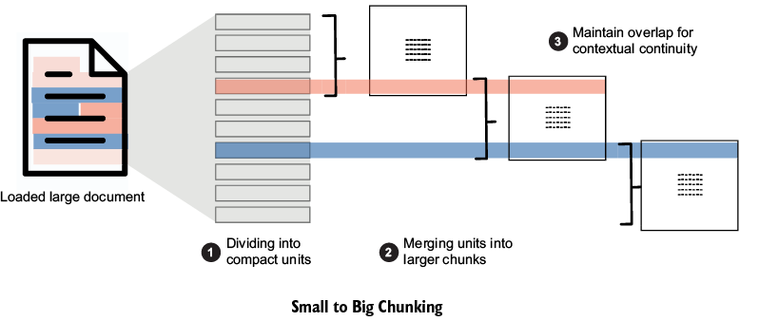
Data Splitting (Chunking)
Breaking down long pieces of text to manageable segments is called data splitting or chunking.
Why Chunking :
Context window of LLMs
Lost-in-the-middle problem
Ease of Search
2 important aspects of chunking
The manner of text splitting
Measuring of the chunk size

Slide 10
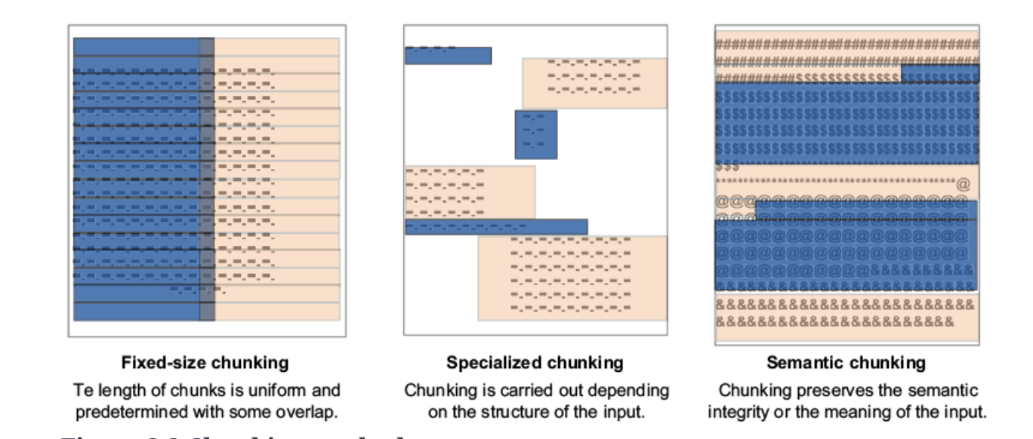
Chunking Methods
Chunking strategy will be based on
Nature of content
Expected length / complexity of user query
Application/ Use case req

Slide 11
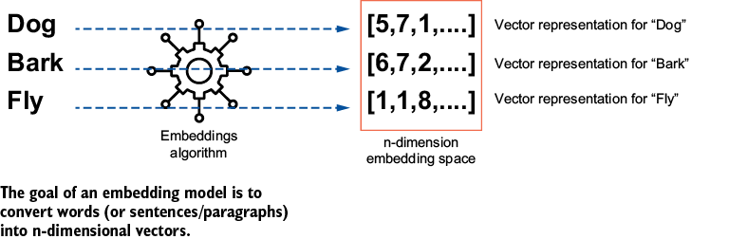
Data Conversion(Embeddings)
Any format to Numbers (Vectors)
Old school NLP Embedding Algo – Glove , Word2Vec, Elmo, Bert
LLM Based : Nemo , OpenAI Embedding , Gemini Embedding etc

Slide 12
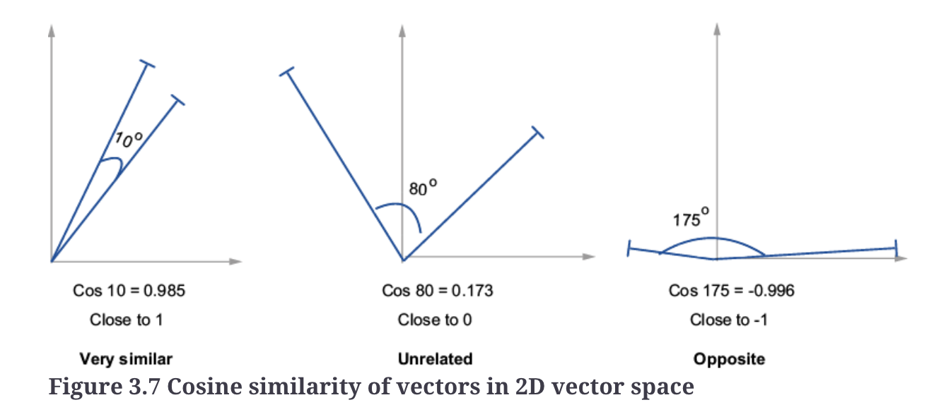
Embedding Similarity
Cosine Similarity
L2/Euclidean Similiarity
Euclidean distance between two vectors. Close vectors have a small Euclidean distance.
It can be calculated using the following formula:
Distance (A, B) = sqrt((A_{i}-B_{i})²),
where i is the i-th dimension of the n-dimensional vectors
Selection will be based on how Embedding models were trained
If embedding trained on direction heavy (e.g., contrastive loss in Siamese networks) , go with cosine
If model trained with L2-based losses (e.g., triplet loss with Euclidean margins) focus on minimizing absolute distances between similar items, go with l2

Slide 13
Data Storage (Vector DBs)
Categories of Vector DB
Vector indexes—These are libraries that focus on the core features of indexing and search. They do not support data management, query processing, or interfaces. They can be considered a bare-bones vector database. Examples of vector indexes are Facebook AI Similarity Search (FAISS), Non-Metric Space Library (NMSLIB), Approximate Nearest Neighbors Oh Yeah (ANNOY), Scalable Nearest Neighbors (ScaNN), and similar.
Specialized vector DBs—These databases focus on the core feature of high-dimensional vector support, indexing, search, and retrieval such as vector indexes, but also offer database features such as data management, extensibility, security, scalability, non-vector data support, and similar. Examples of specialized vector DBs are Pinecone, ChromaDB, Milvus, Qdrant, Weaviate, Vald, LanceDB, Vespa, and Marqo.
Search platforms—Solr, Elastic Search, Open Search, and Apache Lucene are traditional text search platforms and engines built for full text search. They have now added vector similarity search capabilities to their existing search capabilities.
Vector capabilities for SQL databases—Azure SQL, Postgres SQL(pgvector), SingleStore, and CloudSQL are traditional SQL databases that have now added vector data-handling capabilities.
Vector capabilities for NoSQL databases—Like SQL DBs, NoSQL DBs such as MongoDB have also added vector search capabilities.
Graph databases with vector capabilities—Graph DBs such as Neo4j, have also opened new possibilities by adding vector capabilities

Slide 14
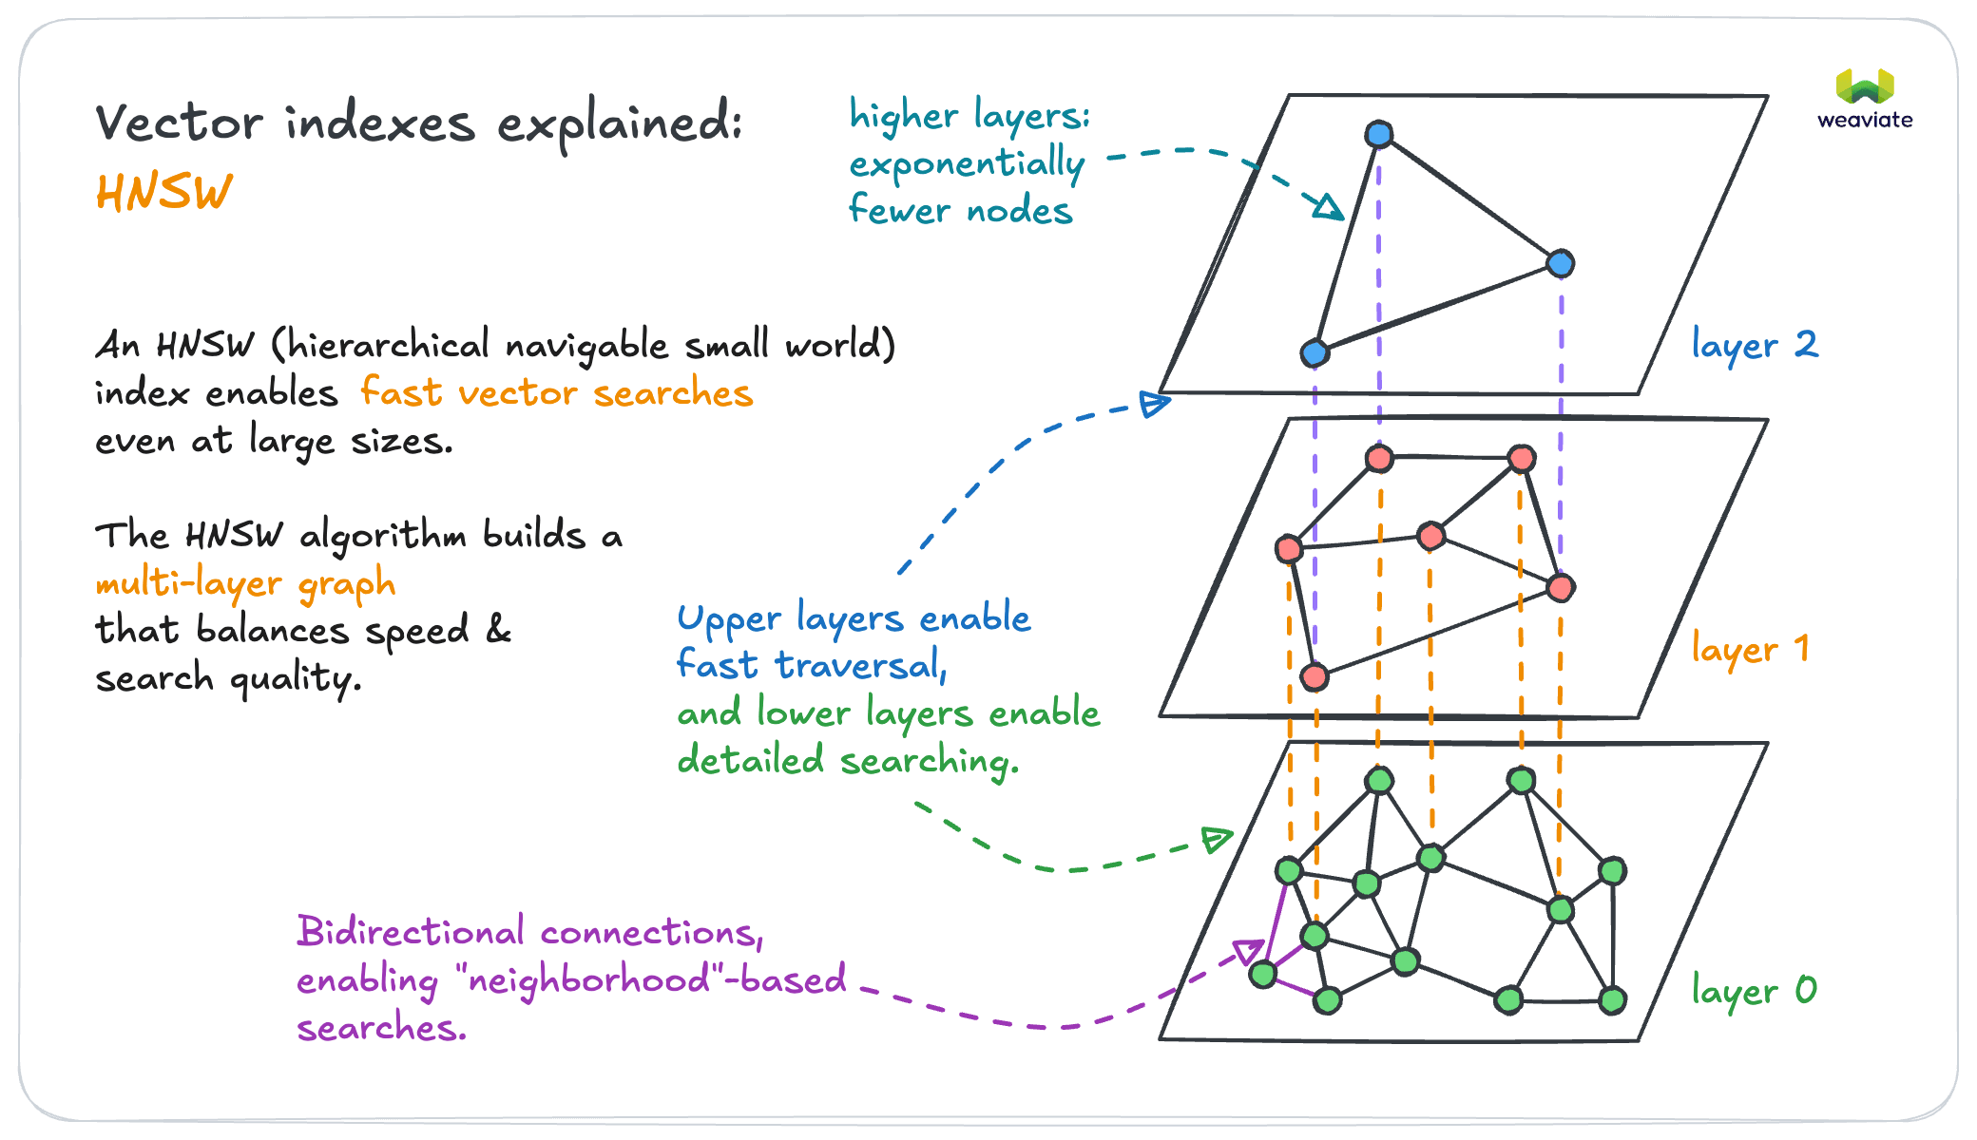
Vector Indexing
A vector index is a data structure that organizes vector embeddings to enable efficient similarity search.
Indexing vector databases properly is crucial for performance, and different index types serve different purposes - from the simple flat index to more sophisticated approaches like HNSW.

Slide 15
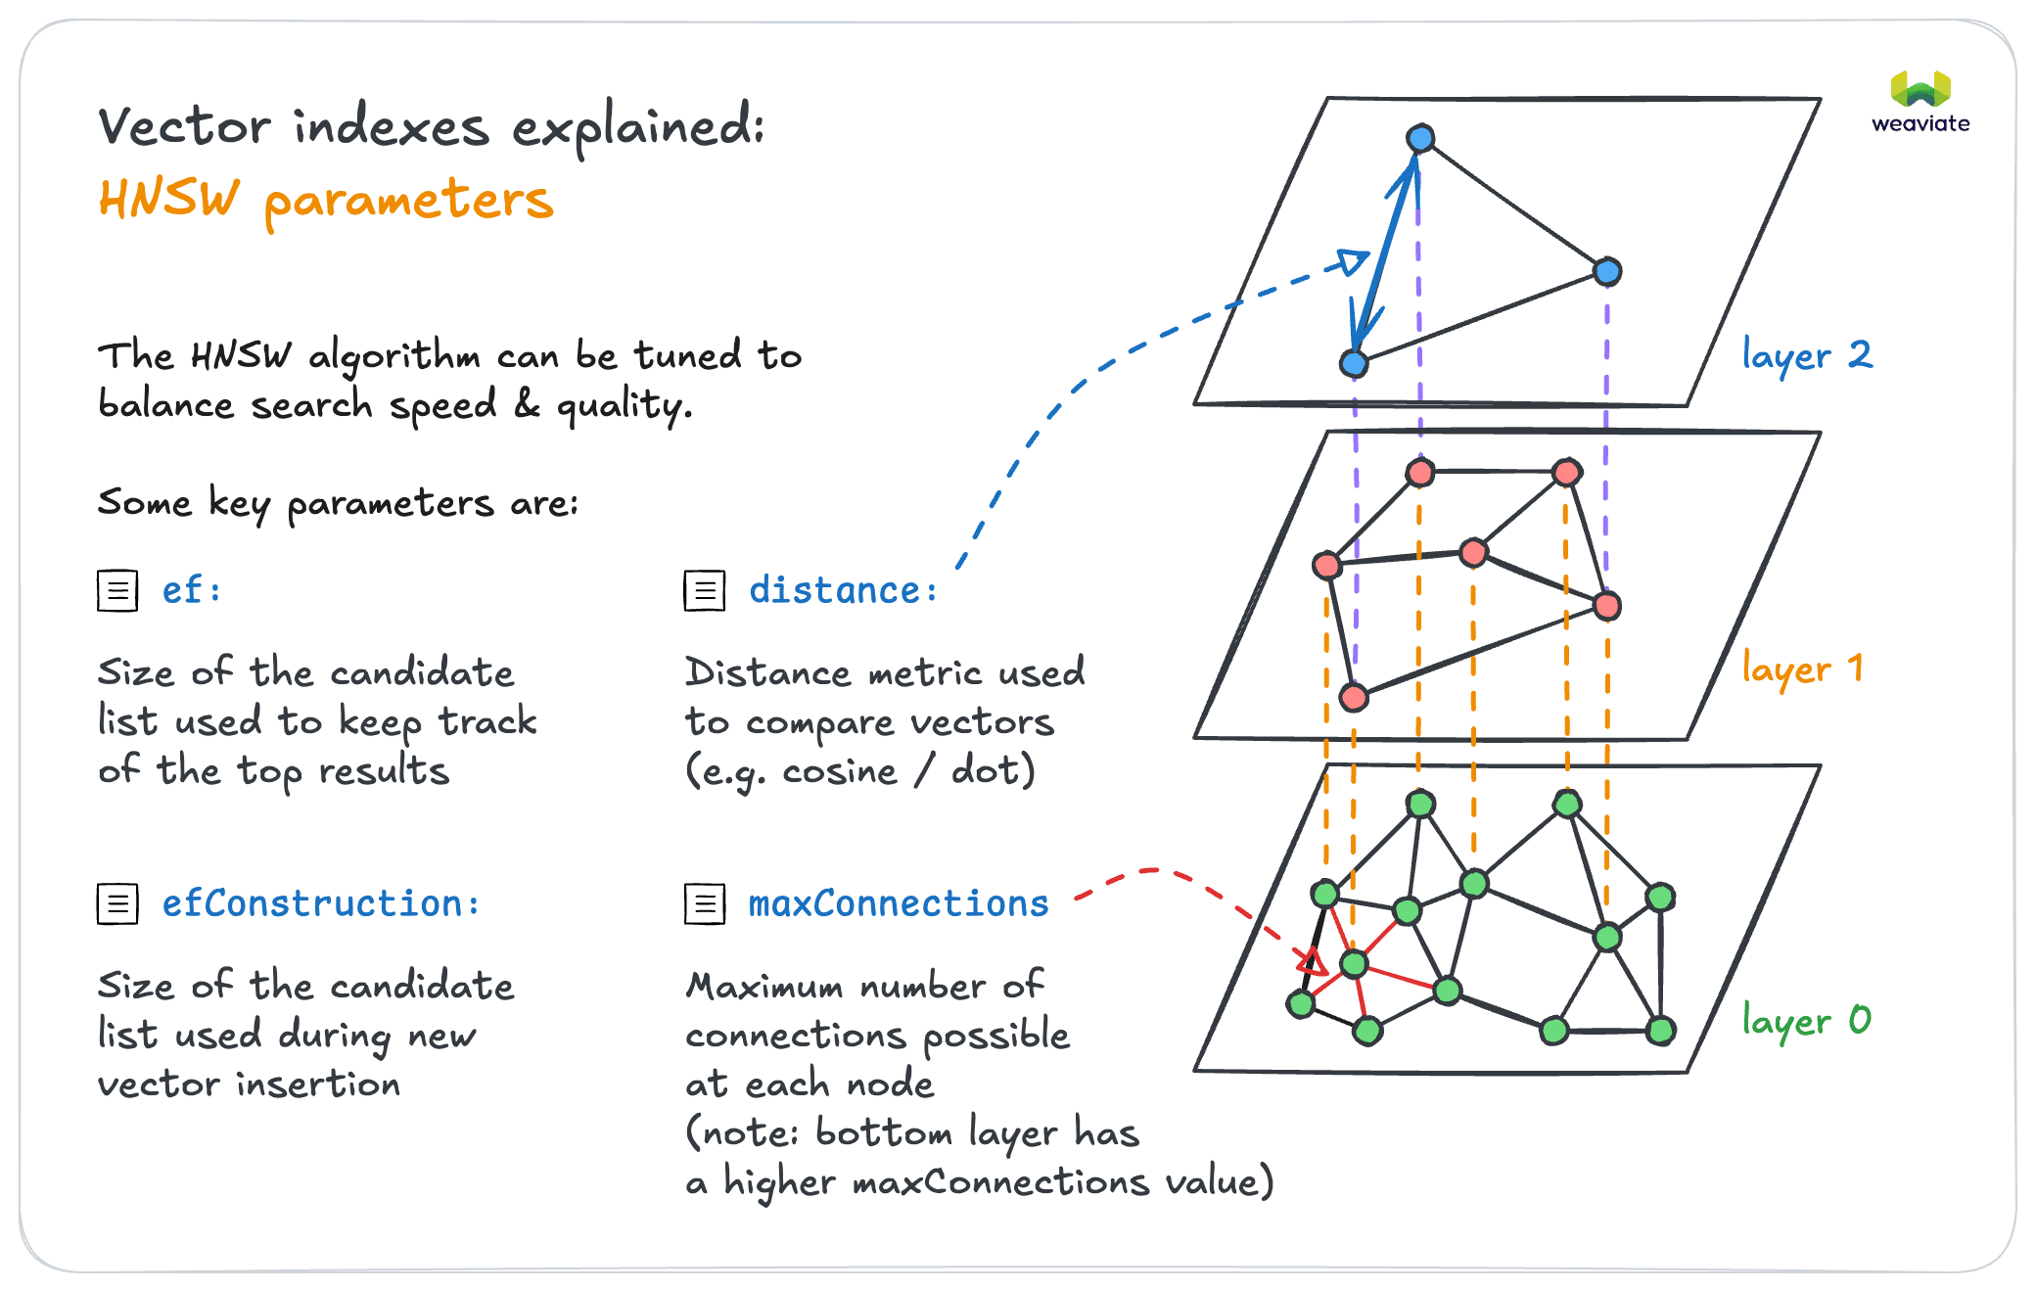
Indexing Hyper parameters

Slide 16
Choosing Vector DB
Accuracy vs. speed—Certain algorithms are more accurate but slower. A balance between search accuracy and query speed must be achieved based on application needs. It will become important to evaluate vector DBs on these parameters.
Flexibility vs. performance—Vector DBs provide customizations to the user. While it may help you in tailoring the DB to your specific requirements, more customizations can add overhead and slow systems down.
Local vs. cloud storage—Assess tradeoffs between local storage speed and access versus cloud storage benefits like security, redundancy, and scalability.
Direct access vs. API—Determine if tight integration control via direct libraries is required or if ease-of-use abstractions like APIs better suit your use case.
Simplicity vs. advanced features—Compare advanced algorithm optimizations, query features, and indexing versus how much complexity your use case necessitates versus needs for simplicity.
Cost—While you may incur regular costs in a fully managed solution, a self-hosted one might prove costlier if not managed well.

Slide 17
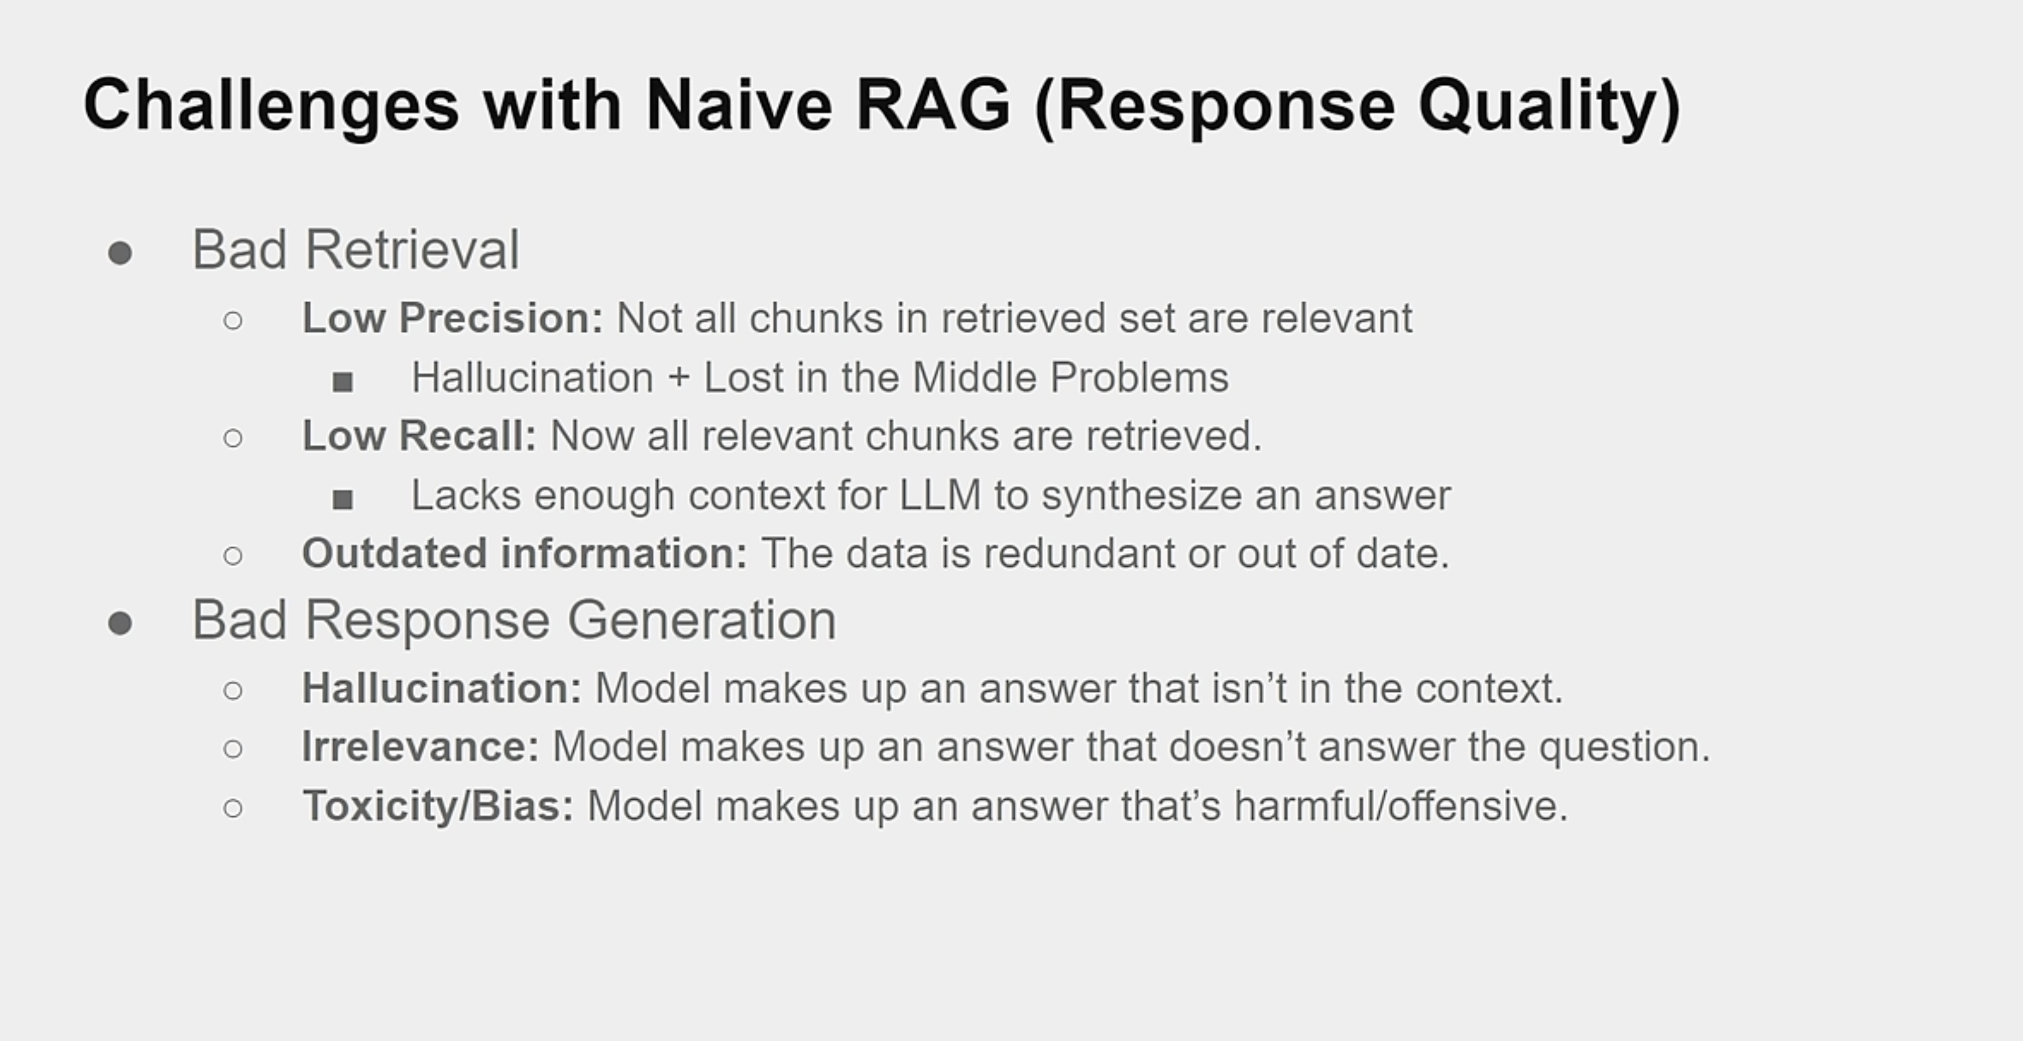

Slide 18
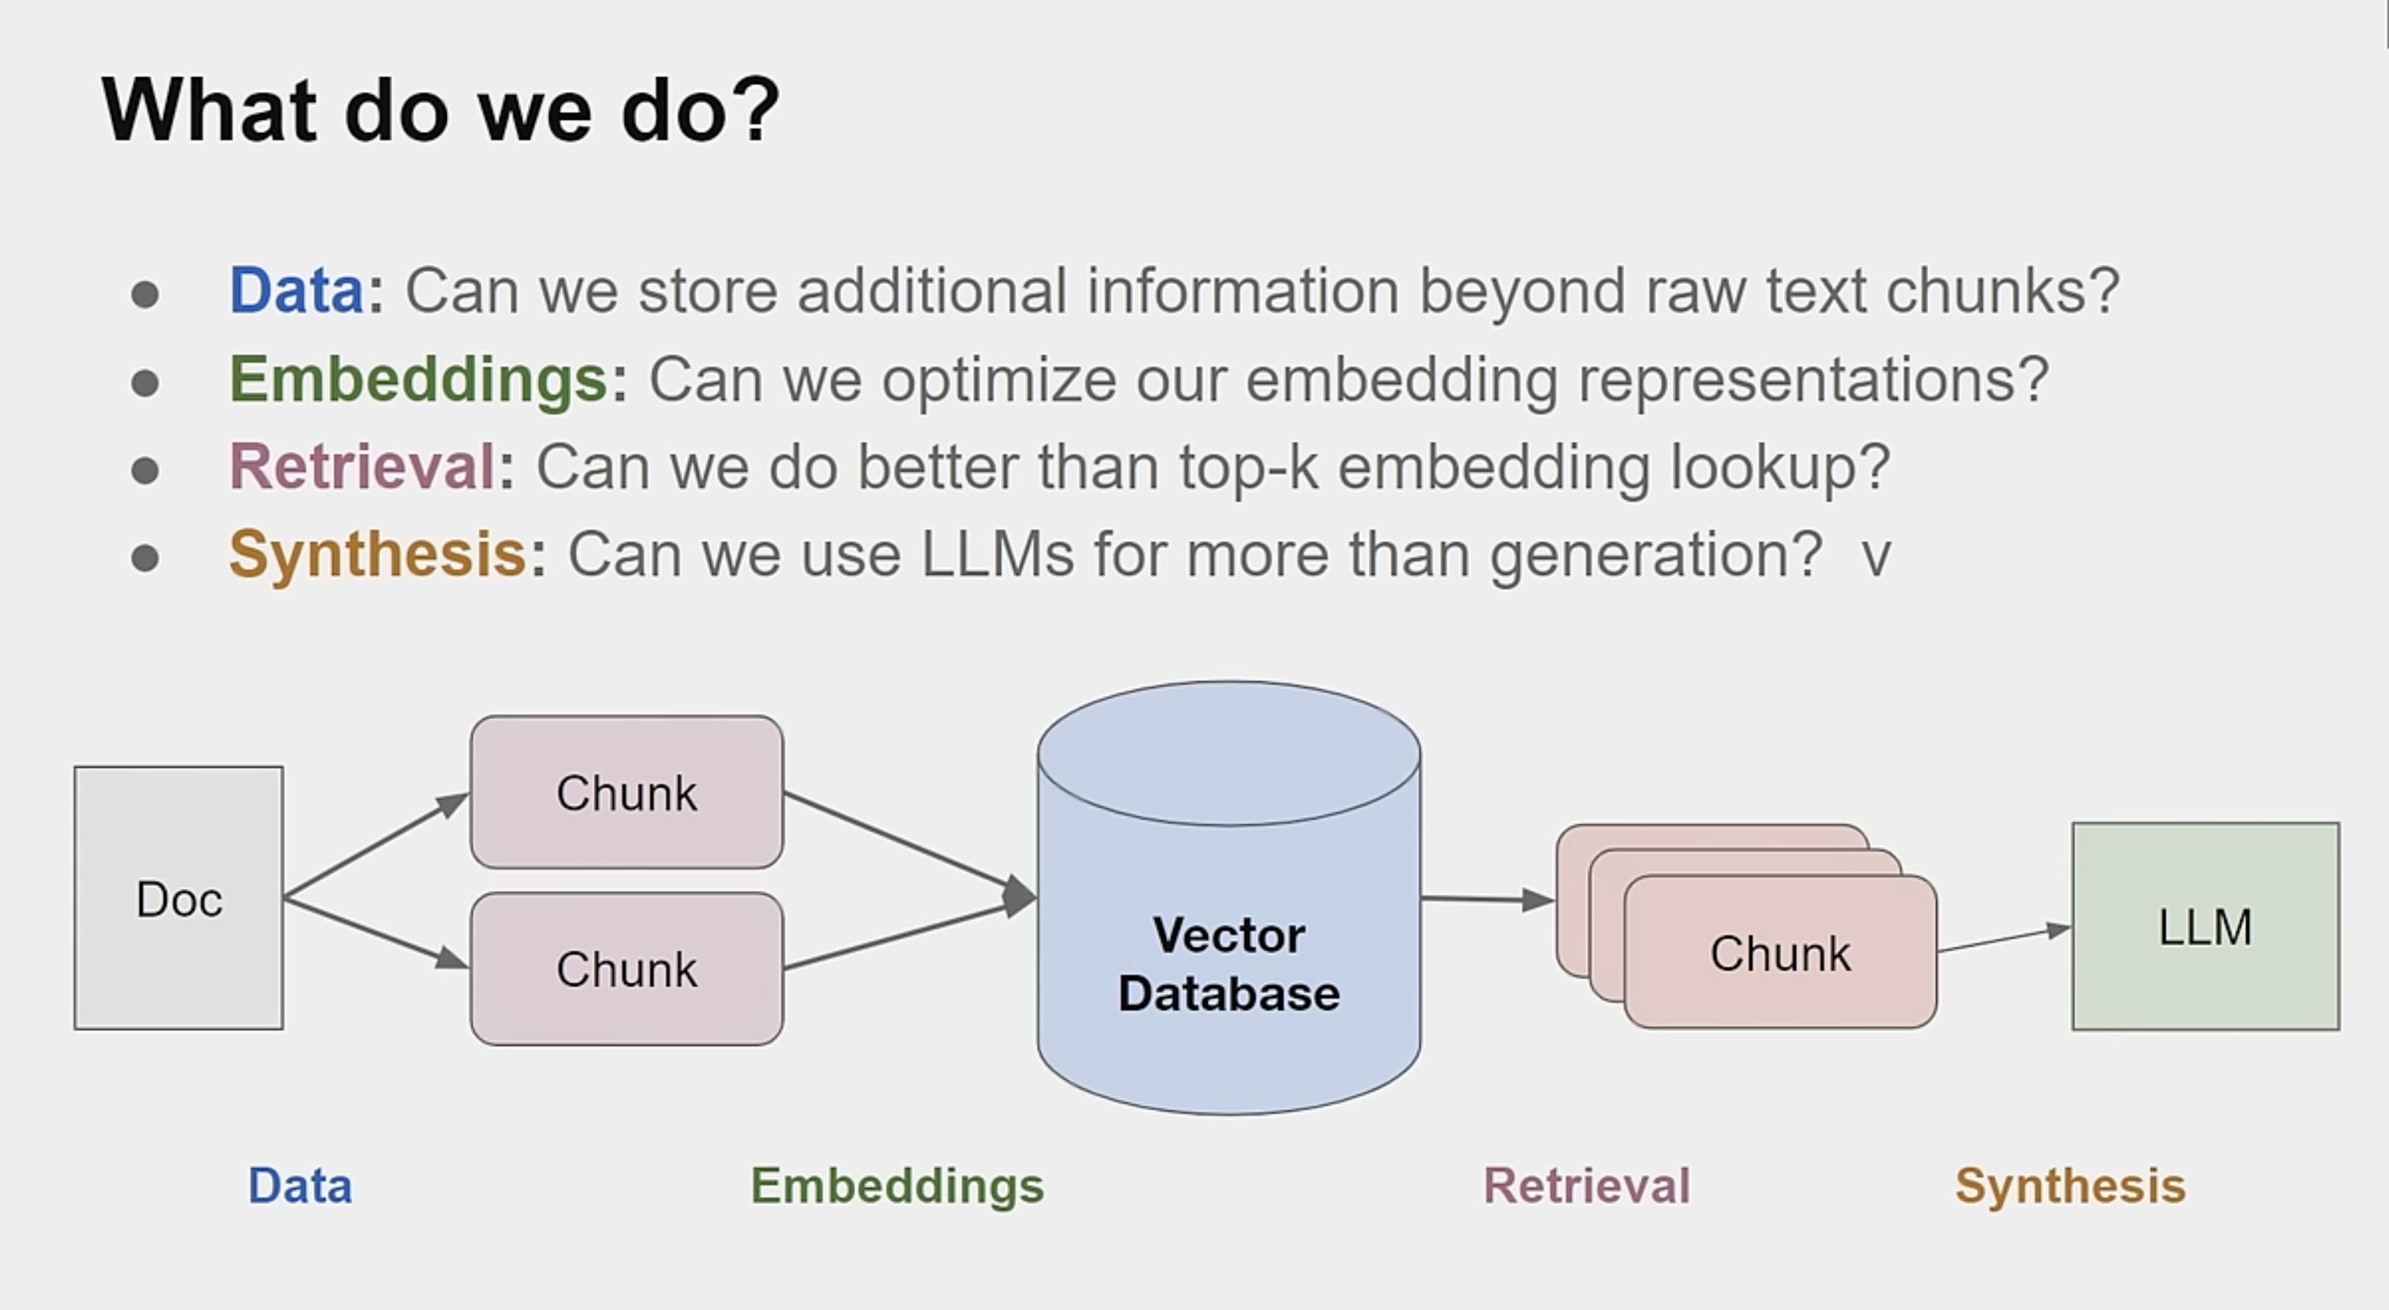

Slide 19
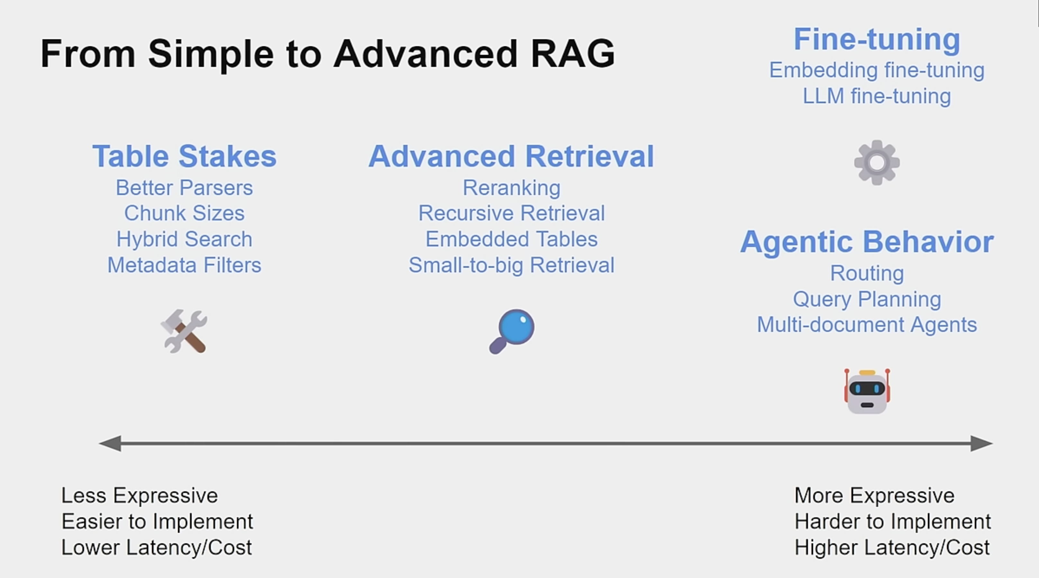

Slide 20
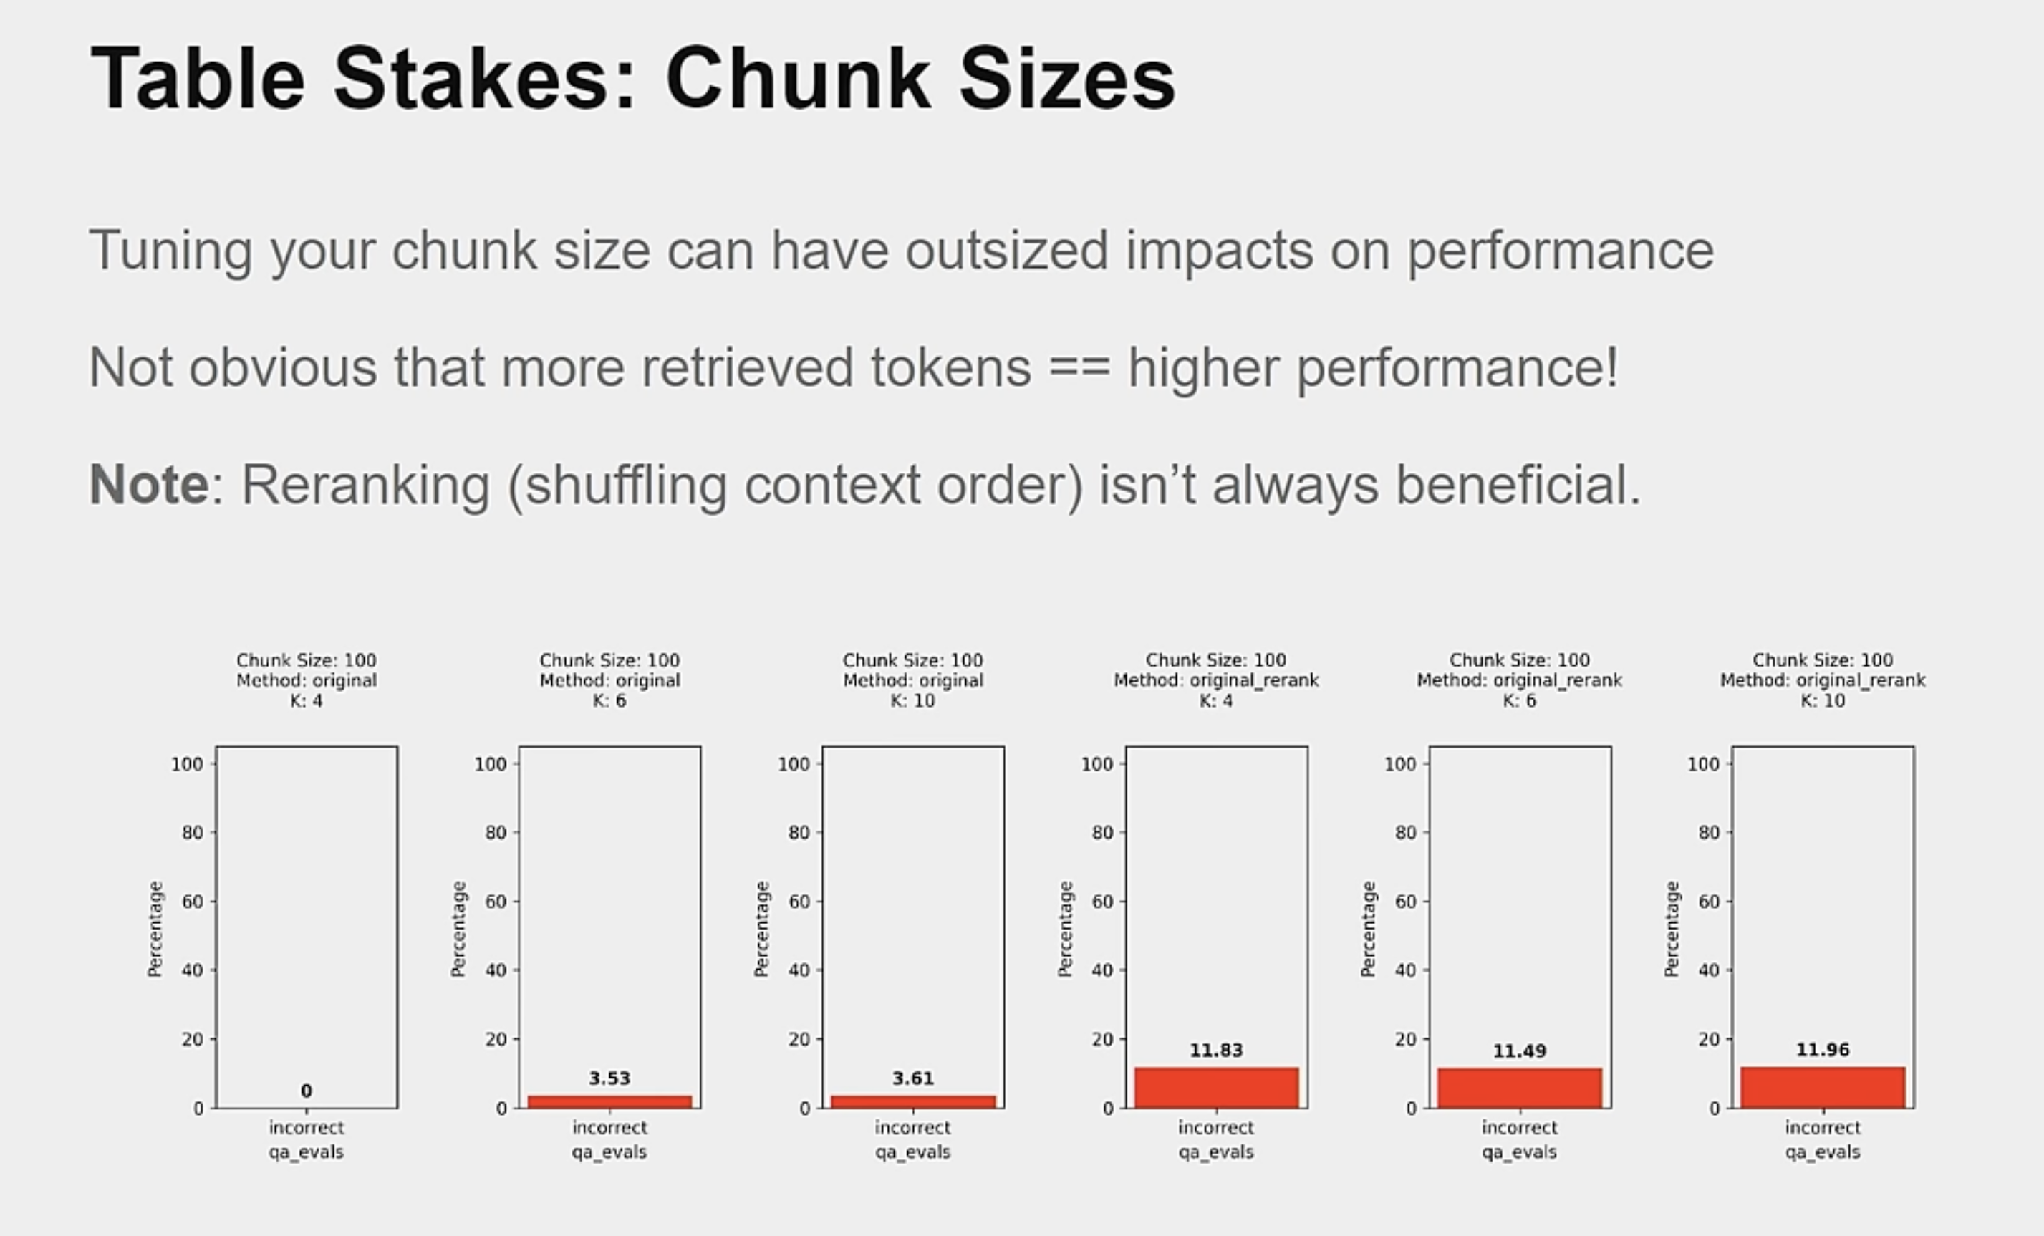

Slide 21
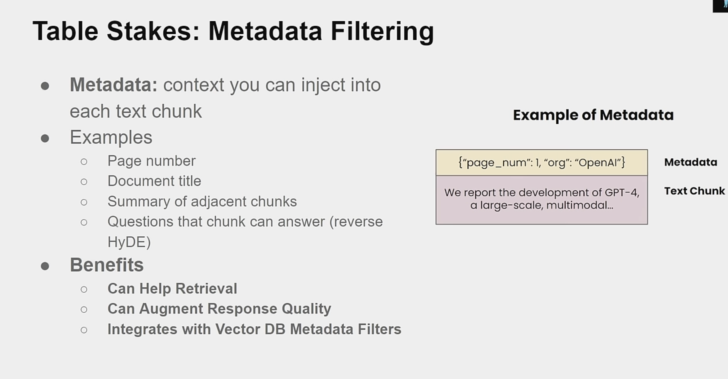

Slide 22
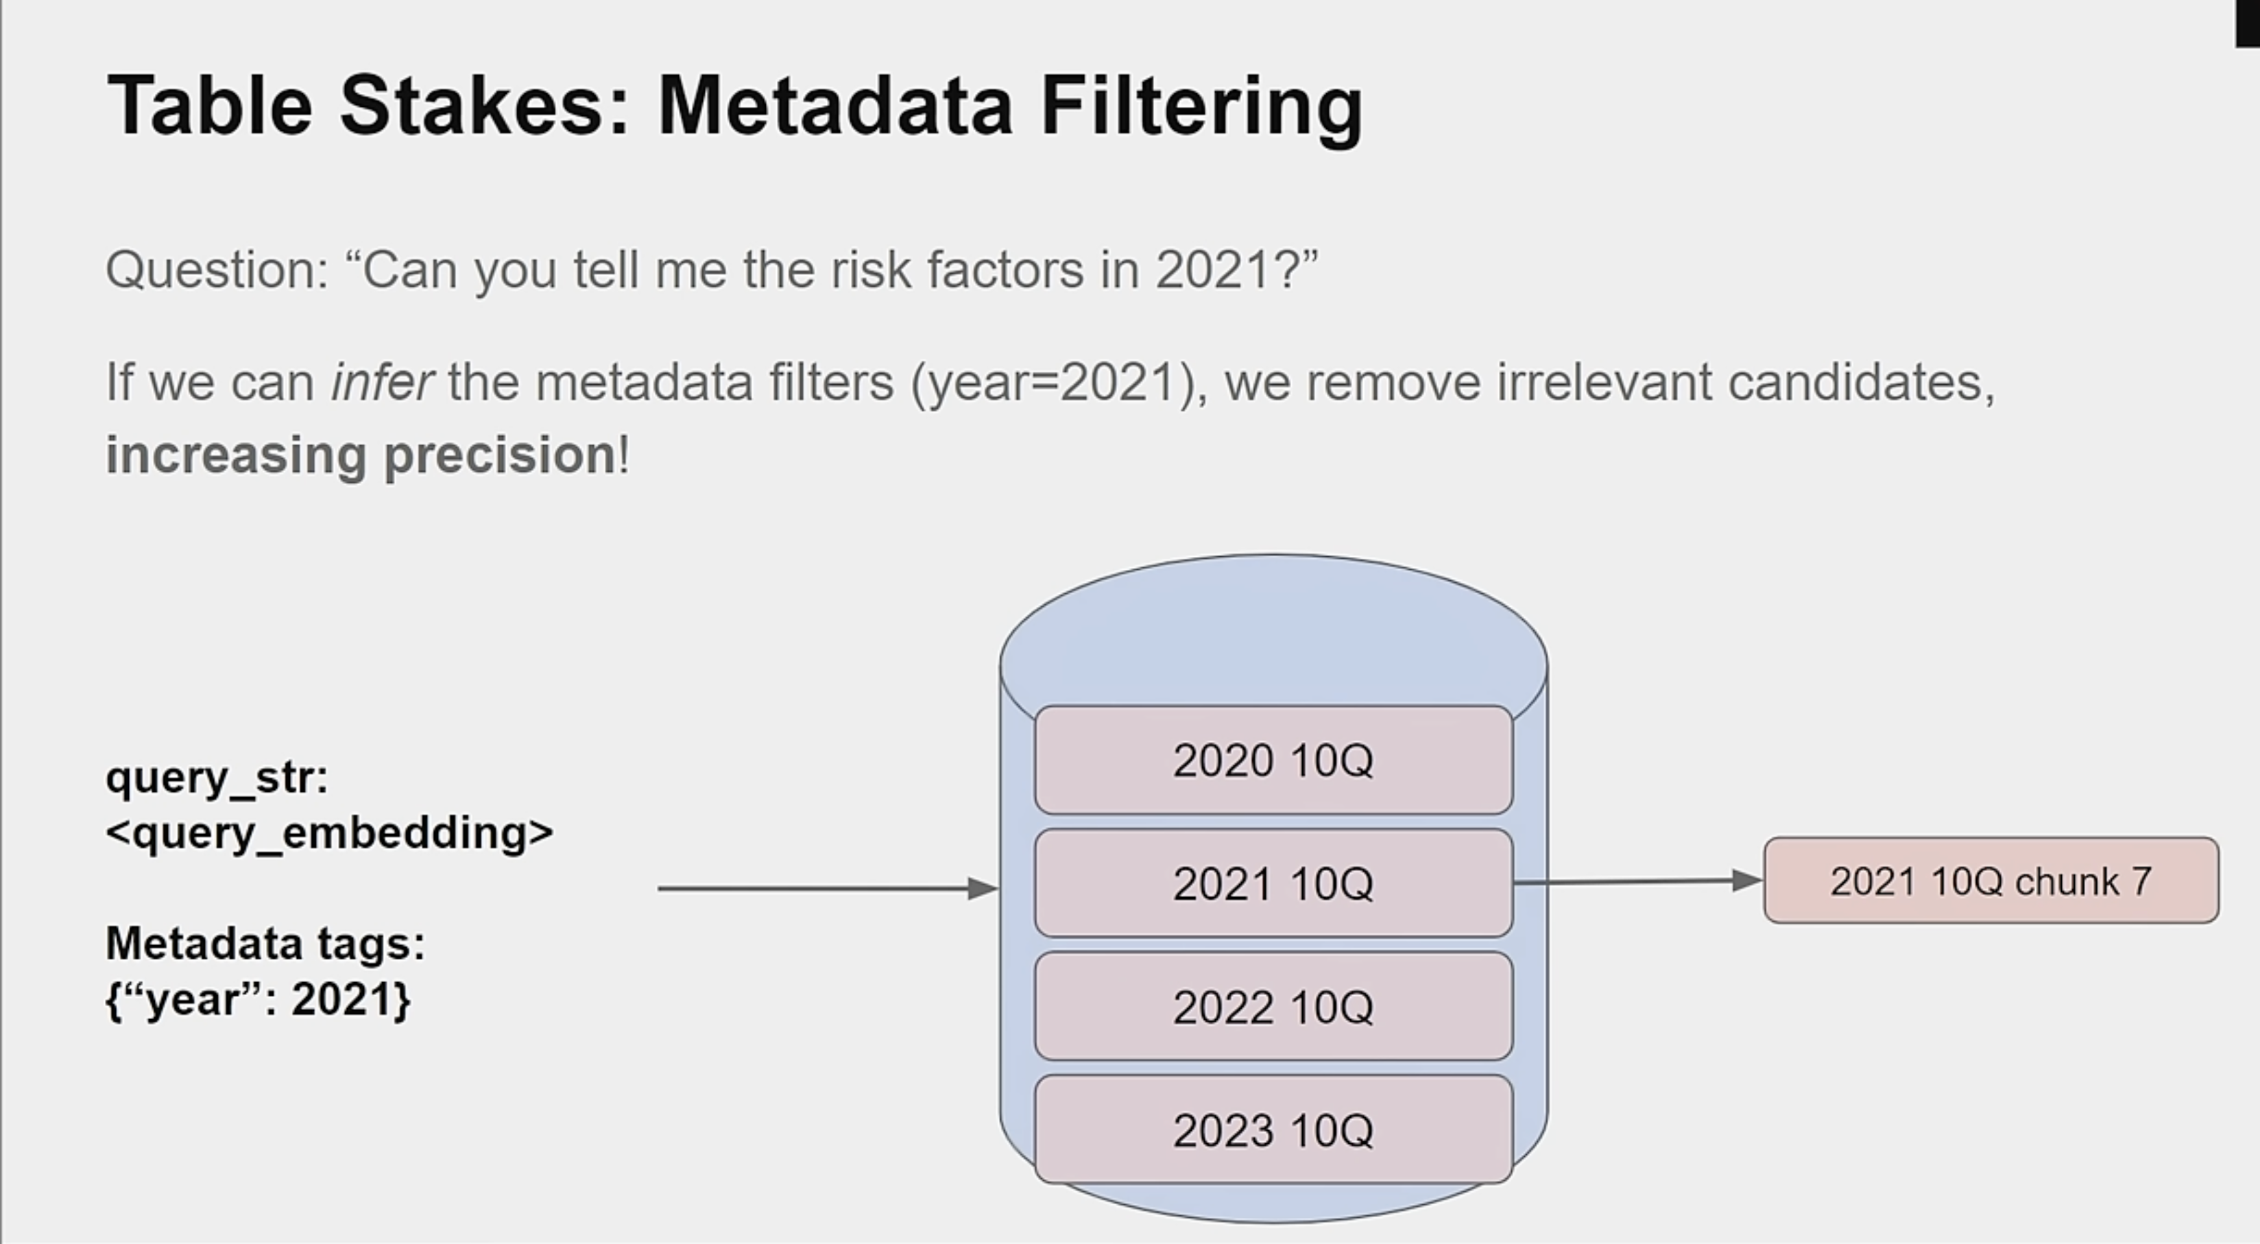

Slide 23
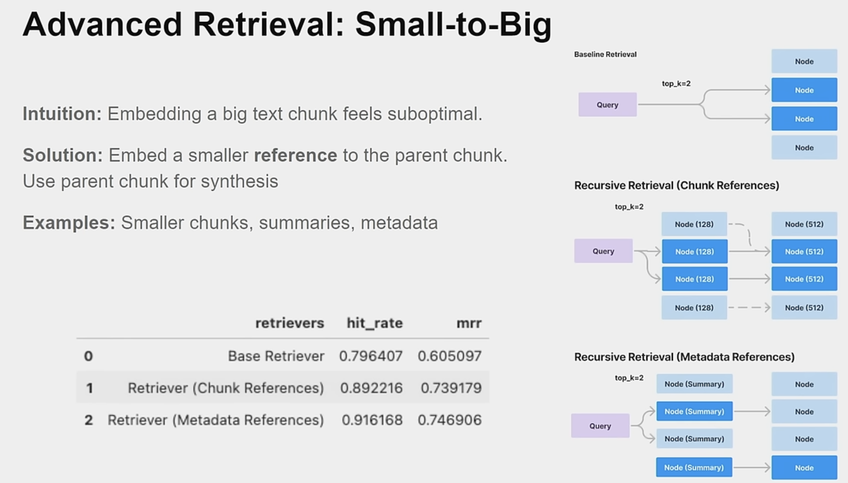

Slide 24
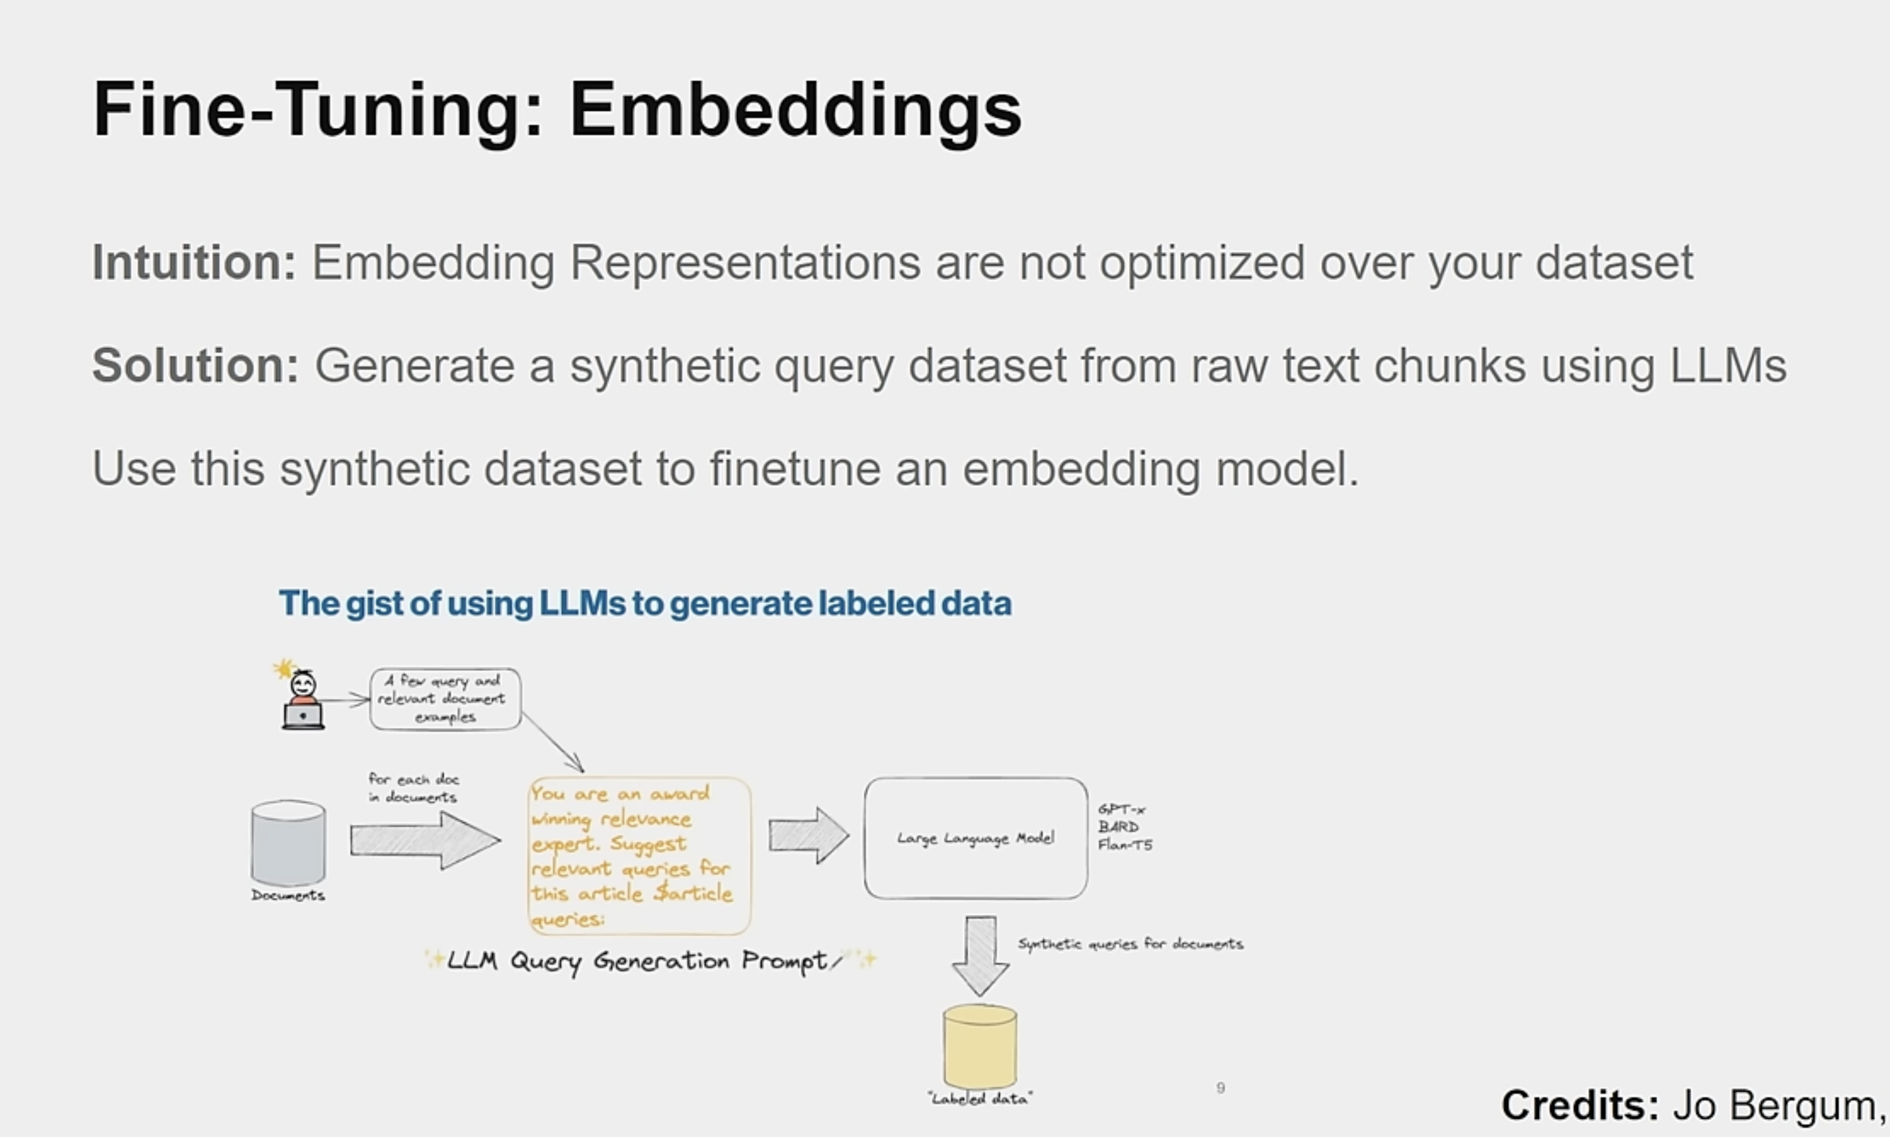

Slide 25
Demo of Basic RAG with RAGAS

Slide 26
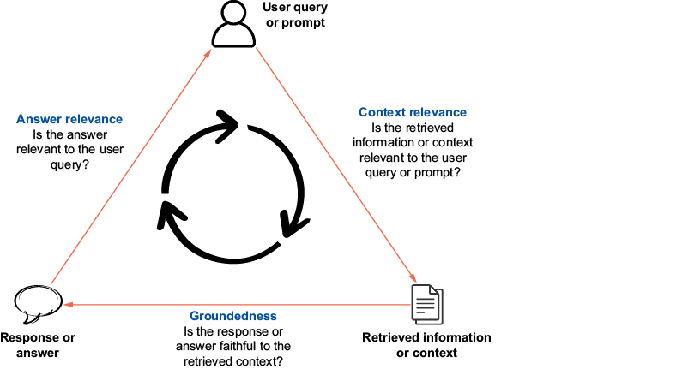
RAG evaluation
The triad of RAG evaluation
proposed by TruEra

Slide 27
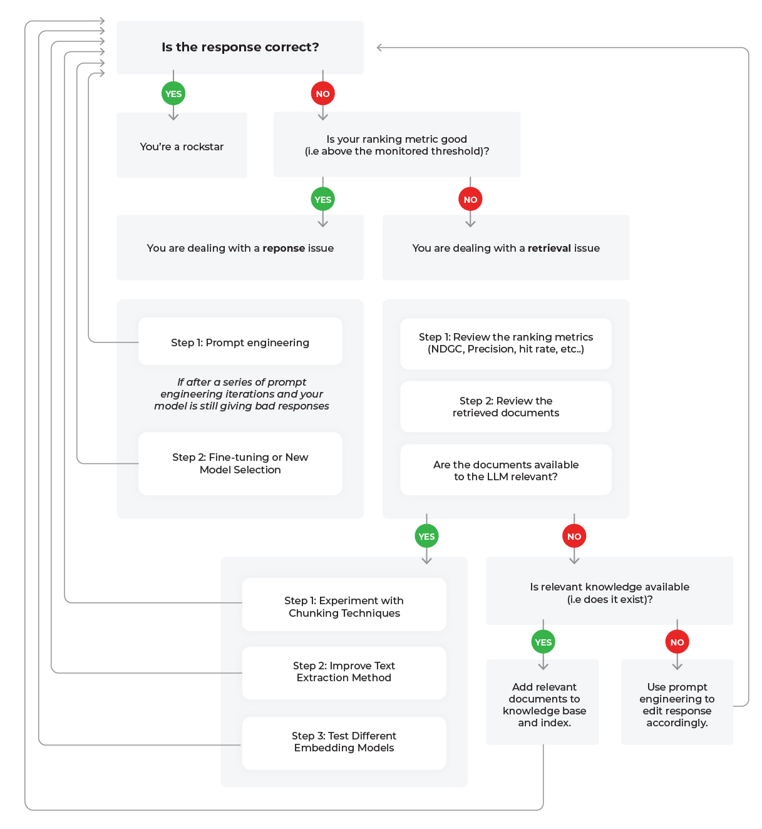
Evaluation
How good is the retrieval of the context from the knowledge base?
Is it relevant to the query?
How much noise (irrelevant information) is present?
How good is the generated response?
Is the response grounded in the provided context?
Is the response relevant to the query?
Metrics :
Context relevance
Answer faithfulness
Answer relevance
F1, Precision , Recall , F1
Framework – Ragas ,

Slide 28
Advanced RAG
MultiModal RAG –
Extends capabilities of the standard RAG beyond text data and incorporates other data types such as images, video, and audio. This characteristic enables the system to fetch information from nontextual documents and provide additional context.
Knowledge Graph RAG-
Integrates knowledge graphs into the retrieval process. Knowledge graphs help establish relationships between entities, providing better context, especially in multi-hop queries.
Agentic RAG
Incorporates LLM agents into the RAG framework. These agents enable autonomous decision making across the RAG value chain from indexing to generation. Simultaneously, all components become adaptive to the user query.

Slide 29
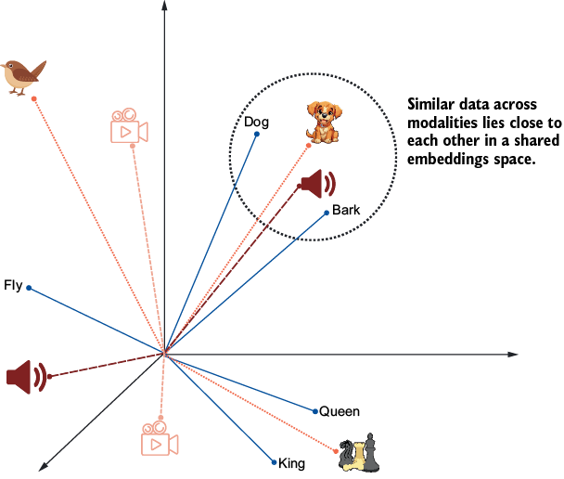
MultiModal
MultiModal Embedding Model
Images, text, video, and audio are plotted on the same embeddings space. Dog, bark, and dog’s image are close to each other.

Slide 30
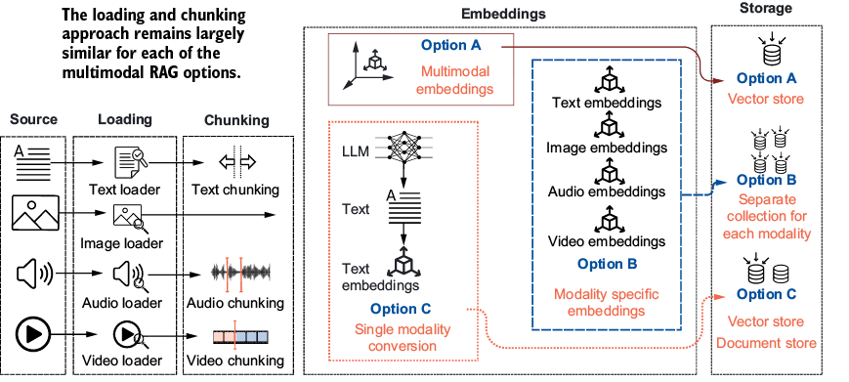
MultiModal RAG pipelines

Slide 31
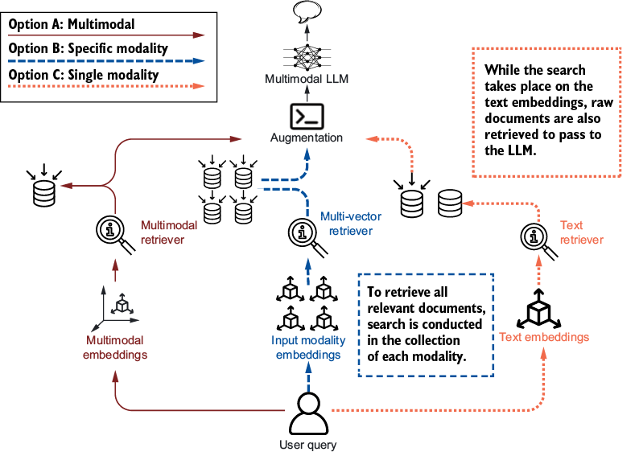
MultiModal RAG generation

Slide 32
Knowledge Graph
Complex queries which needs more context
Summarize the report
Which products in the catalog are endorsed by same celebrities
TO anwer these you need
multi-hop reasoning
identifying contextual relationships
addressing higher-order queries
Needs a powerful RAG pattern that incorporates knowledge graphs has been widely successful.

Slide 33
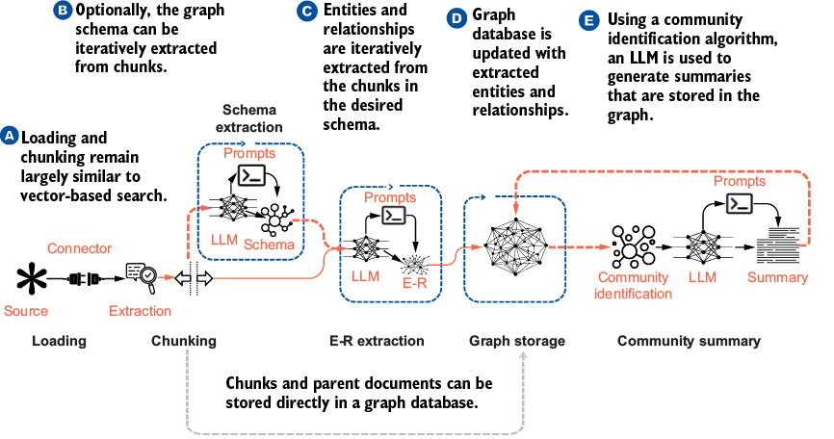
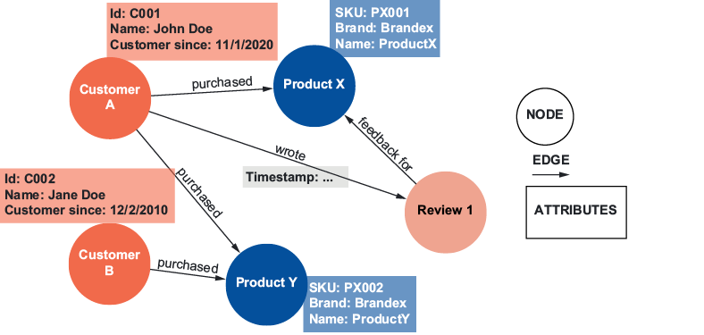
GraphRAG

Slide 34
Agentic RAG
Four Components of an Agent
LLM –Brain/ Reasoning model responsible for understanding goal
Memory – Manage’s agent’s past experiences
Planner –ReAct - Task decomposition or breaking down complex tasks into smaller, manageable subtasks.
Tools assist - the agent in performing actions on resources external to it. This can be conducting a web search on the internet, querying an external database such as an SQL database, invoking a third-party API such as a weather API

Slide 35
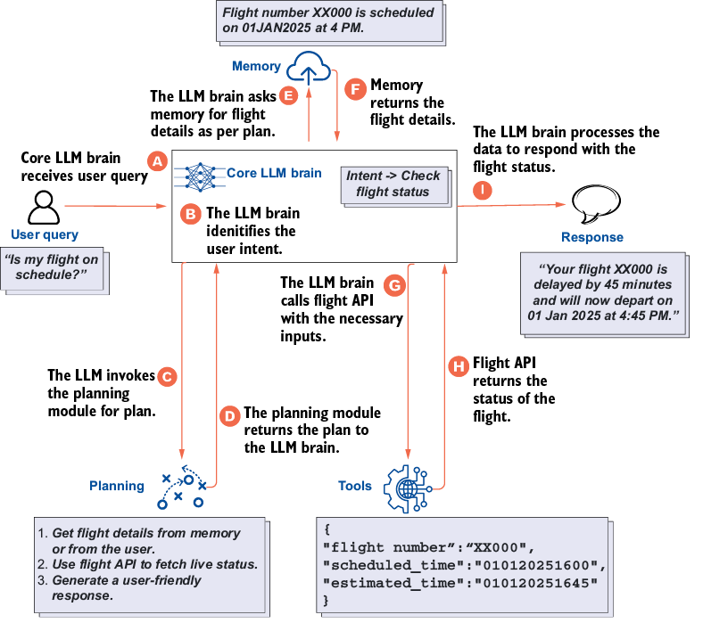
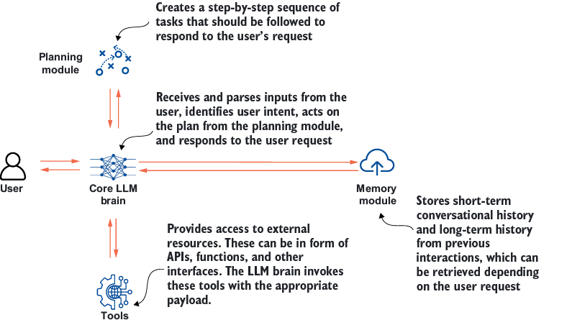
Agent flow
Task Example

Slide 36
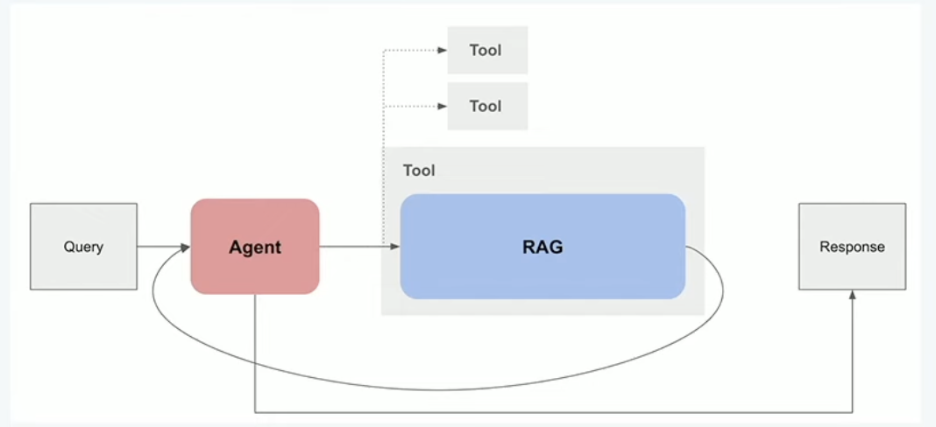
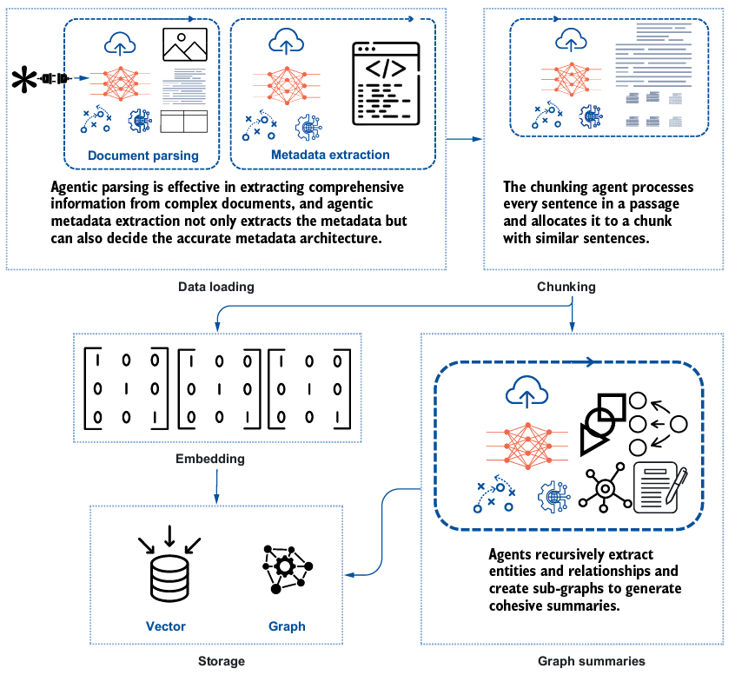
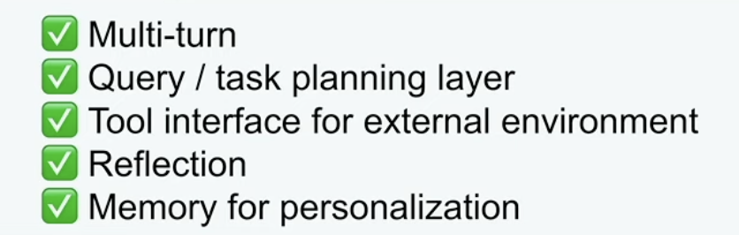
Agents in RAG pipeline

